Slide 1
Digital Watermarking and Steganography - Mini Project SoSe 2019
Group 11: Sarah Böning, Anh Phoung Lee, Kai Gerrit Lünsdorf

Slide 2
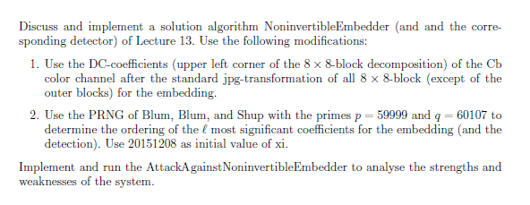
The Exercise

Slide 3
Our Interpretation
Implement 3 algorithms: Embedder, Attacker, Detector
Embedder: follows given algorithm, but embed watermark on a random path (generated by BBS) of the upper left corner DCT coefficients of the Cb-colour channel
Detector: Takes watermarked & original image and computes the similarity
Attacker: follows given algorithm, tries to embed his own watermark
Analysis of the Watermarking System
Rightful Ownership Problem (Multiple public watermarked images)
Robustness
Number analysis
Python 3

Slide 4
Implementation - Embedder
Input: c, w, α, key, Output: s
b = hashImage(c)
d = jpgDCT(c)
p = getBBSPath(key)
Embed w following p
If b_{i} = 0: d_{i} = d_{i} + (1+α*w_{i})
else: d_{i} = d_{i} + (1-α*w_{i})
S = inverseJpgDCT(d)

Slide 5
Implementation - Attacker

Slide 6
Implementation - Detector
Pseudocode of our own implementation
Some explanations maybe

Slide 7
Implementation – More Details
BBS PRNG generates a path along the upper left corner DCT coefficients of the 8x8 blocks
Used in all 3 algorithms to prevent division by 0
Not really realistic (would they all know? Not really)
DCT converts image to YCrCb &IDCT back to RGB
Standard jpg-DCT with 100% compression
Watermark is a vector of random numbers drawn from N(0,1)

Slide 8
Analysis
Evaluate the watermarking system
Evaluate the security & robustness of the watermarking system
Find weaknesses & strengths
Hypotheses:
Secure iff keys (BBS parameters) are different
Not secure if keys are the same
Problems when all 3 use different keys
No perceptible differences between c, c‘, s & s‘
Not 100% robust

Slide 9
Analysis - Procedure
Chose several photos with different features
Run the 3 algorithms
Vary: original images c, length of watermark
Statistical tests
χ ² test, number analysis, histograms, fidelity, robustness

Slide 10
Analysis - The Photo Set
Sets with different features for a differentiable evaluation
High contrast
Low contrast
Black and white
Highly textured
Monochrome
„Normal“ pictures / amateur photography
5 in each set (30 in total)

Slide 11





High Contrast

Slide 12


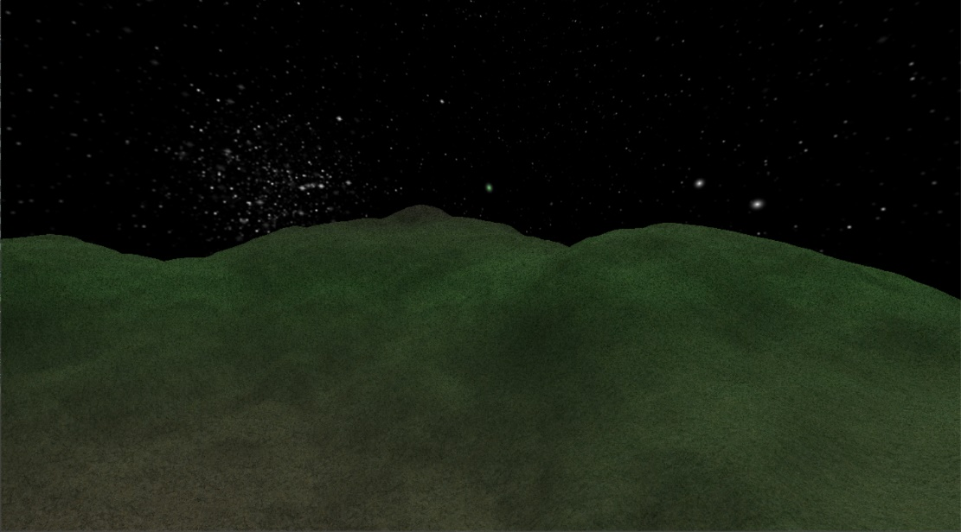

Low contrast

Slide 13

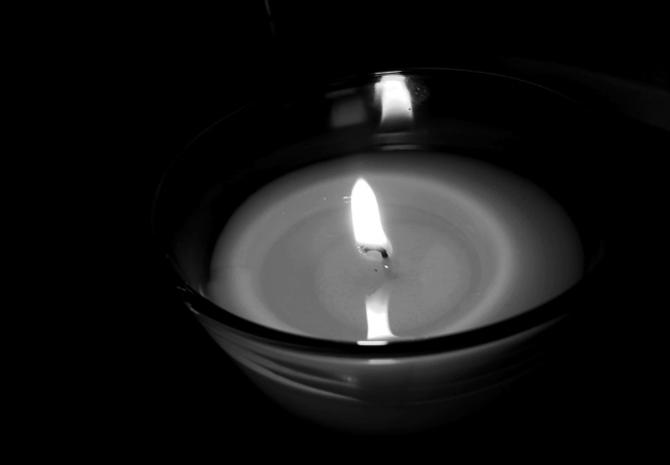
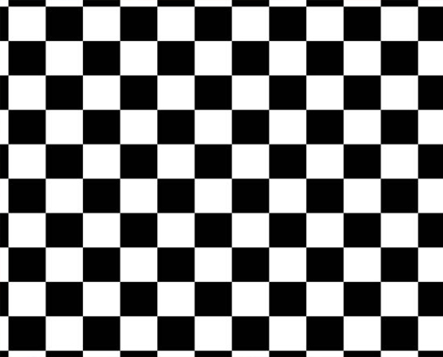

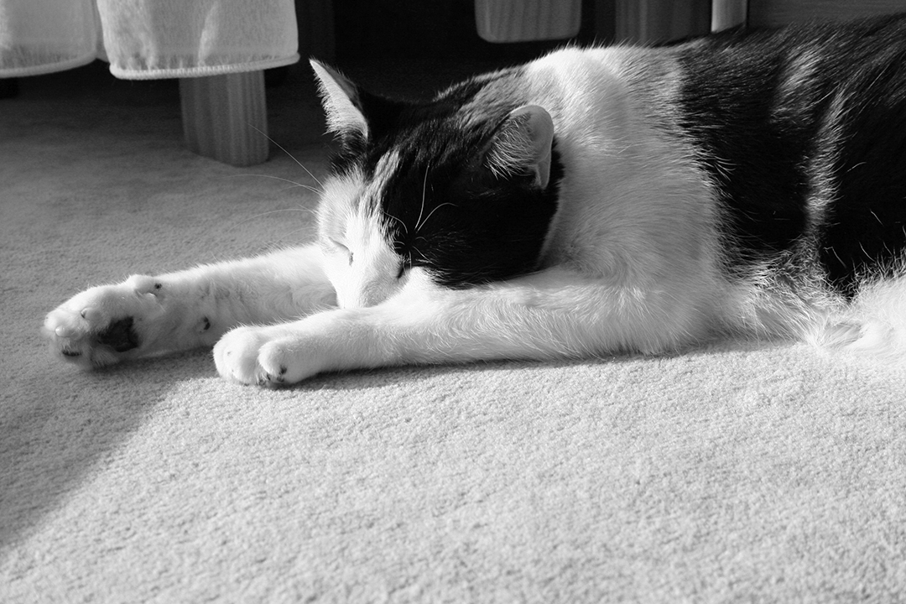
Black and White

Slide 14



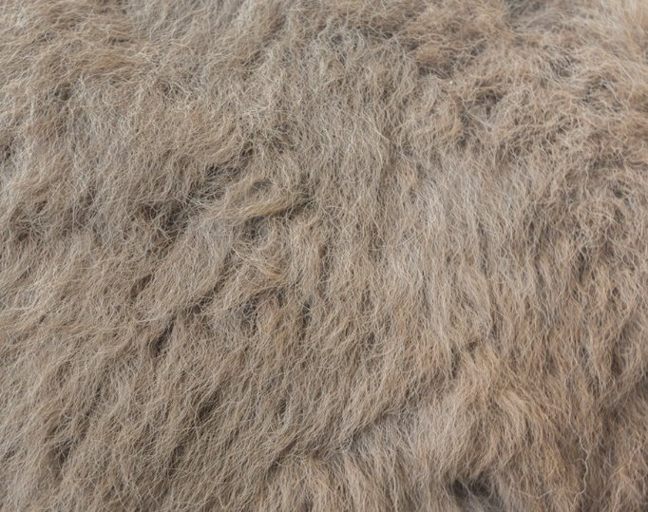
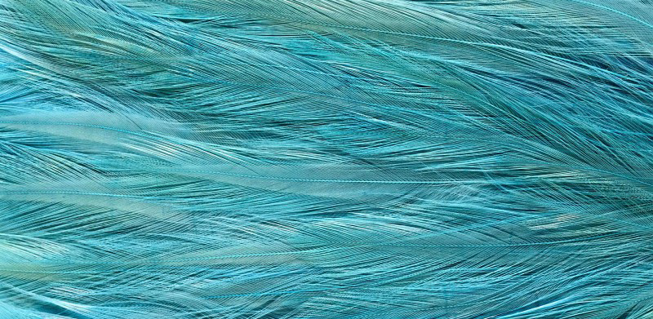
Highly Textured

Slide 15



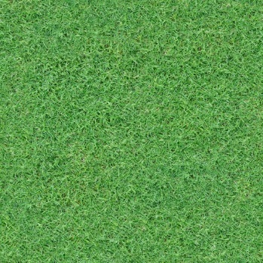

Monochrome

Slide 16
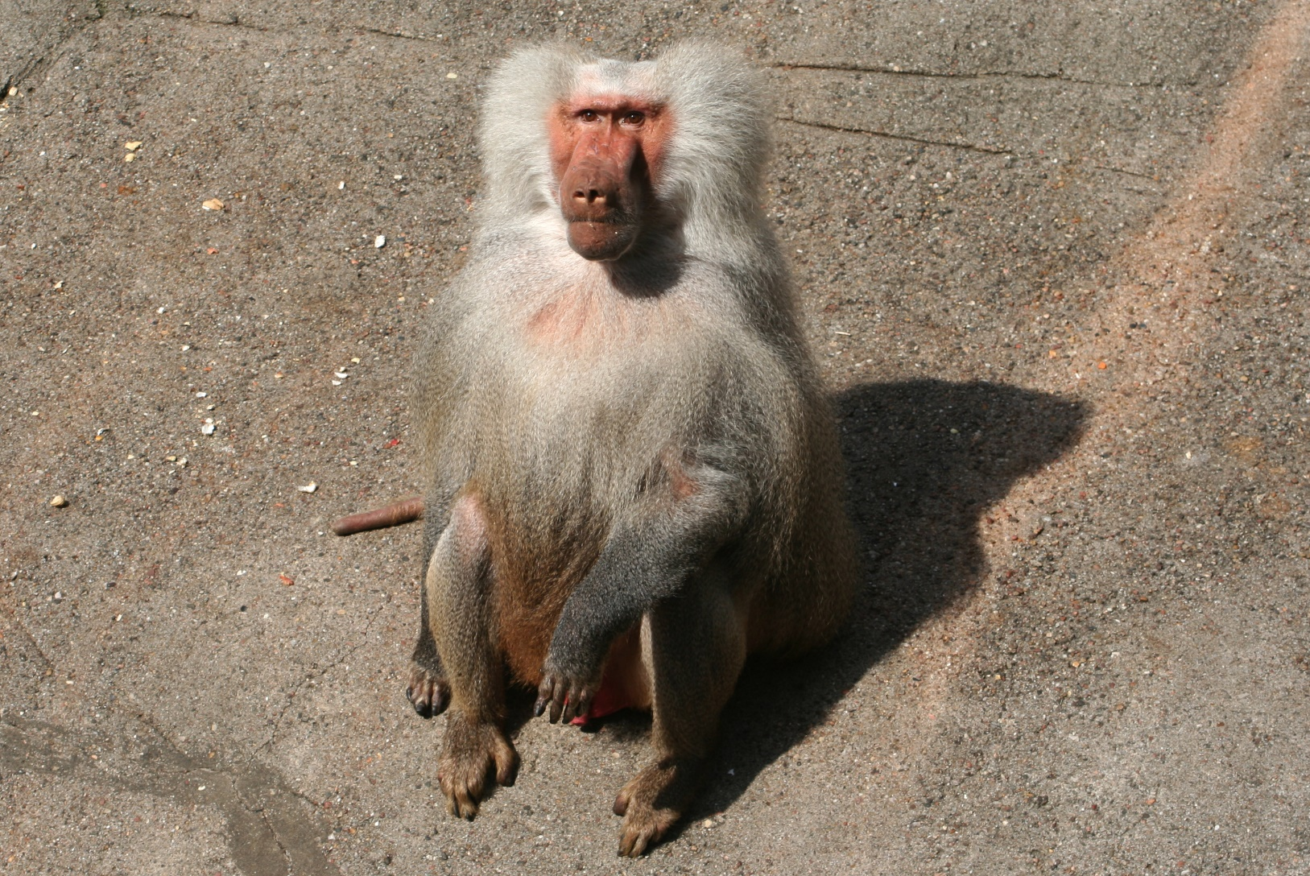
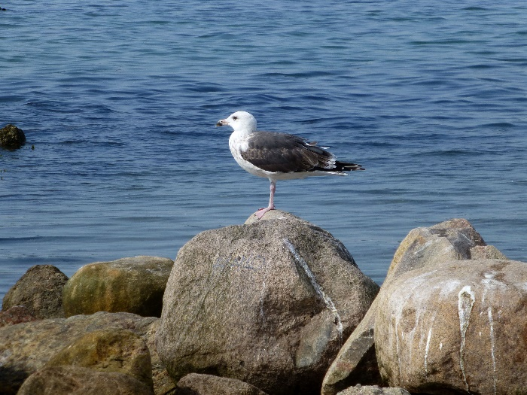
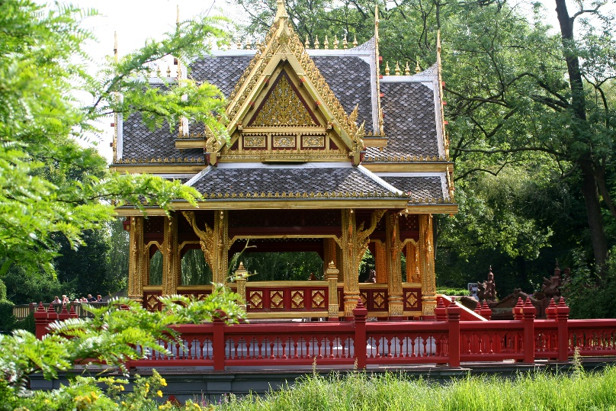
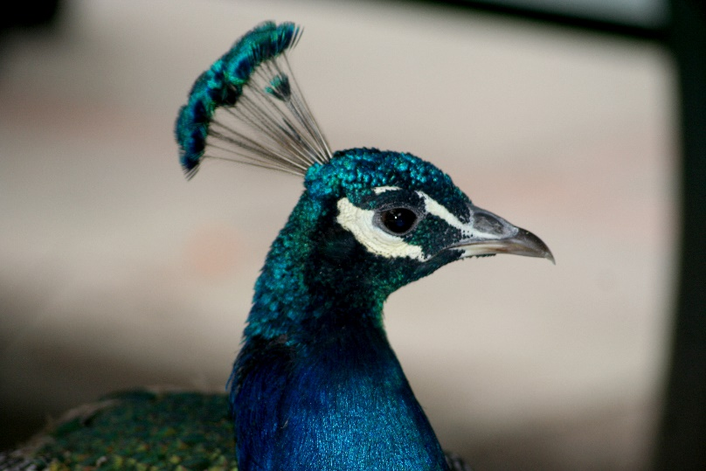
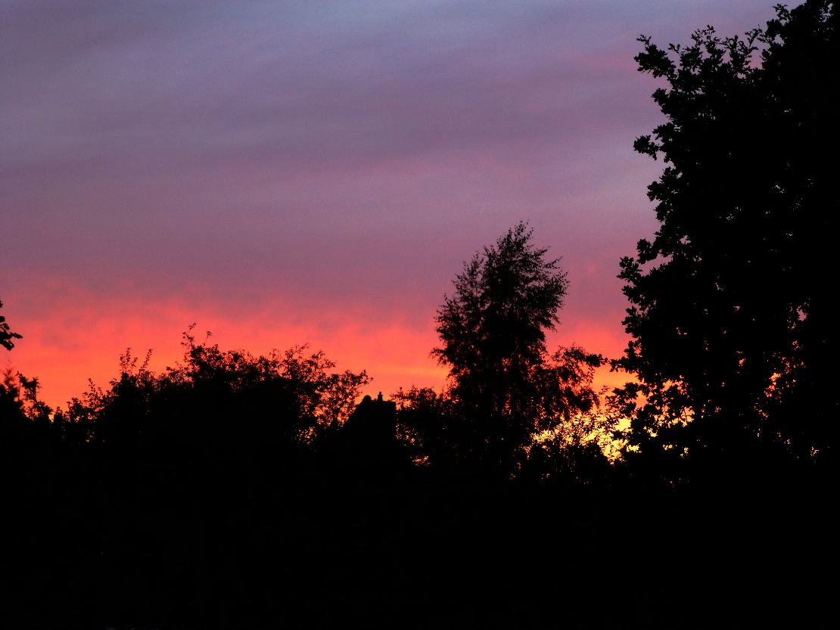
Amateur photography

Slide 17
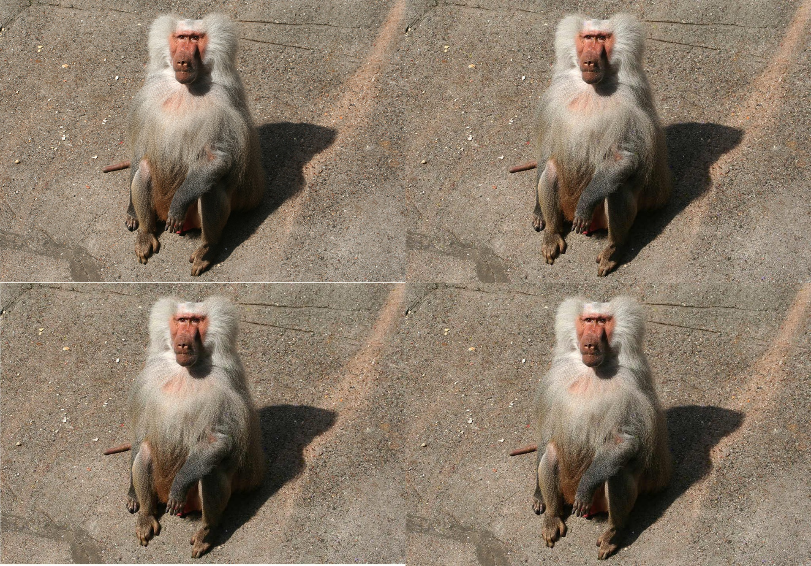
Perceptibility Test – Spot c,s,c‘,s‘

Slide 18
Analysis – Number Analysis
Here, assume that the Embedder & detector share the same seed, attacker has a different one
Annie‘s part (DCT coeff differences & averages, pixel difference and average)

Slide 19
Analysis – Number Analysis
Sarah‘s part (Similarity values, no of successful attacks. No of modified pixels)

Slide 20
Analysis – File size
Original images bigger than others
Fake c same size as s (sometimes -1 KB)
Fake s same size as fake c
First compression: Loss of information & metadata
Attacker uses watermarked image -> same size

Slide 21
Analysis - χ² Test
Since we don‘t embed {0,1} I don‘t think it‘s necessary

Slide 22
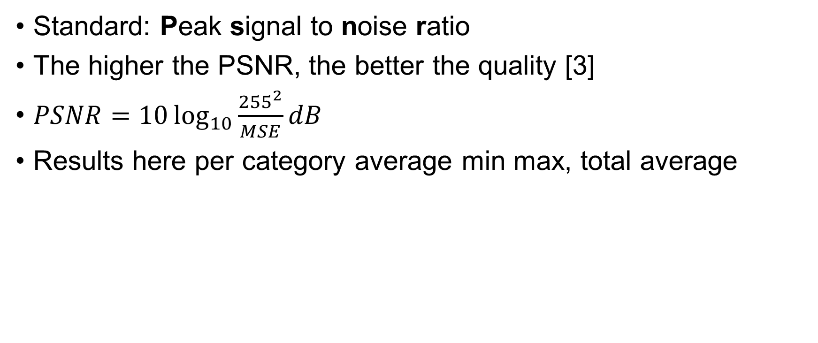
Analysis - Fidelity
Standard: Peak signal to noise ratio
The higher the PSNR, the better the quality [3]
$PSNR=10\log_{10}{\frac{{255}^{2}}{MSE}dB}$
Results here per category average min max, total average

Slide 23
Analysis - Histograms
Annie

Slide 24
Analysis - Robustness
Gerrit

Slide 25
Analysis – Varying the key
Sarah

Slide 26
Analysis – Watermark Lengths
Sarah

Slide 27
Analysis Summary & Conclusion
Is it safe against the Rightful Ownership Problem & the Attacker with multiple public images?
Is is safe in general/ against other attacks?
Strengths and weaknesses of our wm system
How good are our results/limitations
Etc.

Slide 28

Any questions?
Thank you for your attention.

Slide 29
References
[1] Lecture notes „Digital Watermarking and Steganography SoSe 2019“, Andreas Jakoby, Bauhaus University Weimar
[2] Craver, Scott & Memon, Nasir & Yeo, Boon-Lock & Yeung, Minerva. (1997). On The Invertibility Of Invisible Watermarking Techniques. 1. 540 - 543 vol.1. 10.1109/ICIP.1997.647969.
[3] Aliwa, Mehemed Bashir, et al. "Fidelity and Robust Digital Watermarking Adaptively Pixel based on Medial Pyramid of Embedding Error Gray Scale Images." International Journal of Computer Science and Network Security 10.6 (2010): 284-314.
Code: Python 3, Numpy 1.16, matplotlib 3
Images: private, textures.com, rawpixel.com, newevolutionsdesign.com, desktopimages.org, wikipedia

